Slide 1

Pandemic watch
Team WAP

Slide 2
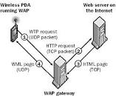
Team Name
We are Team W.A.P.
It stands for Wireless Application Protocol
It is the technical standard for accessing information through mobile wireless networks

Slide 3
Product
Our Team, WAP is in the working of making an application called Pandemic Watch. What this application will achieve is that it will be providing information about Covid-19.In these tough times not a lot of people are not getting information about Covid-19 like what is happening around the world such as certain country or city: cases, recovered, deaths and counter measures are taking to prevent the spend of Covid-19. The goal that we’re trying to aim is to deliver the information to people about different areas in the world from different outlets
Pandemic Watch™

Slide 4
Functionality
The app will format displayed data as to show the user current pandemical news and data
It will display world statistics such as total global cases, total global recovered, and local cases.
There will be oncreate functions that welcome user
The app will request location and language from user
The user will have the option to change settings
The app will retrieve data based on the users answer and display it in the corner for the user to confirm
It will have a feed back option for users to relay information and bugs to the developers
There will be multiple tabs for news, stats, settings, and a form data

Slide 5
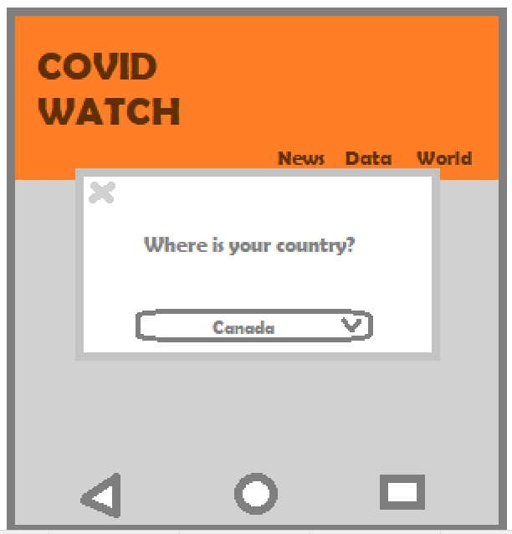
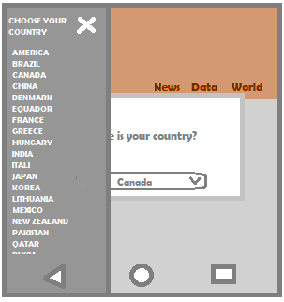
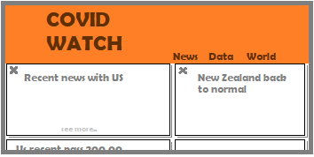

Layout and Design

Slide 6
Our Members
Tsidkeenu Aznar
Satyam Dalvadi
Jagminder Sembi
Rayan Treebhowon

Slide 7
Our Development Strategy
Group leader: Tsidkeennu Aznar
Everyone is in charge of attending bi weekly scrums to discuss the development and direction that the project intends to go
Our progress will be documented through product back logs to allow us to better track the developmental process and the points of occurrence of bugs when they occur in the project
We will do an agile development architecture.

Slide 8
Responsibilities
Satyam: User interface, main page, settings
Tech lead
UI Designer
Tsid: Task assignment, data base management, testing cases
Project manager
Team lead
Jagg: Functionality, language support, image documentation
Tester
UX Designer
Ray: Functionality, language support, image documentation
Lead program supervisor
Front back developer
Business/ promotional manager
We will all be coding, attending scrum meetings

